Slide 1
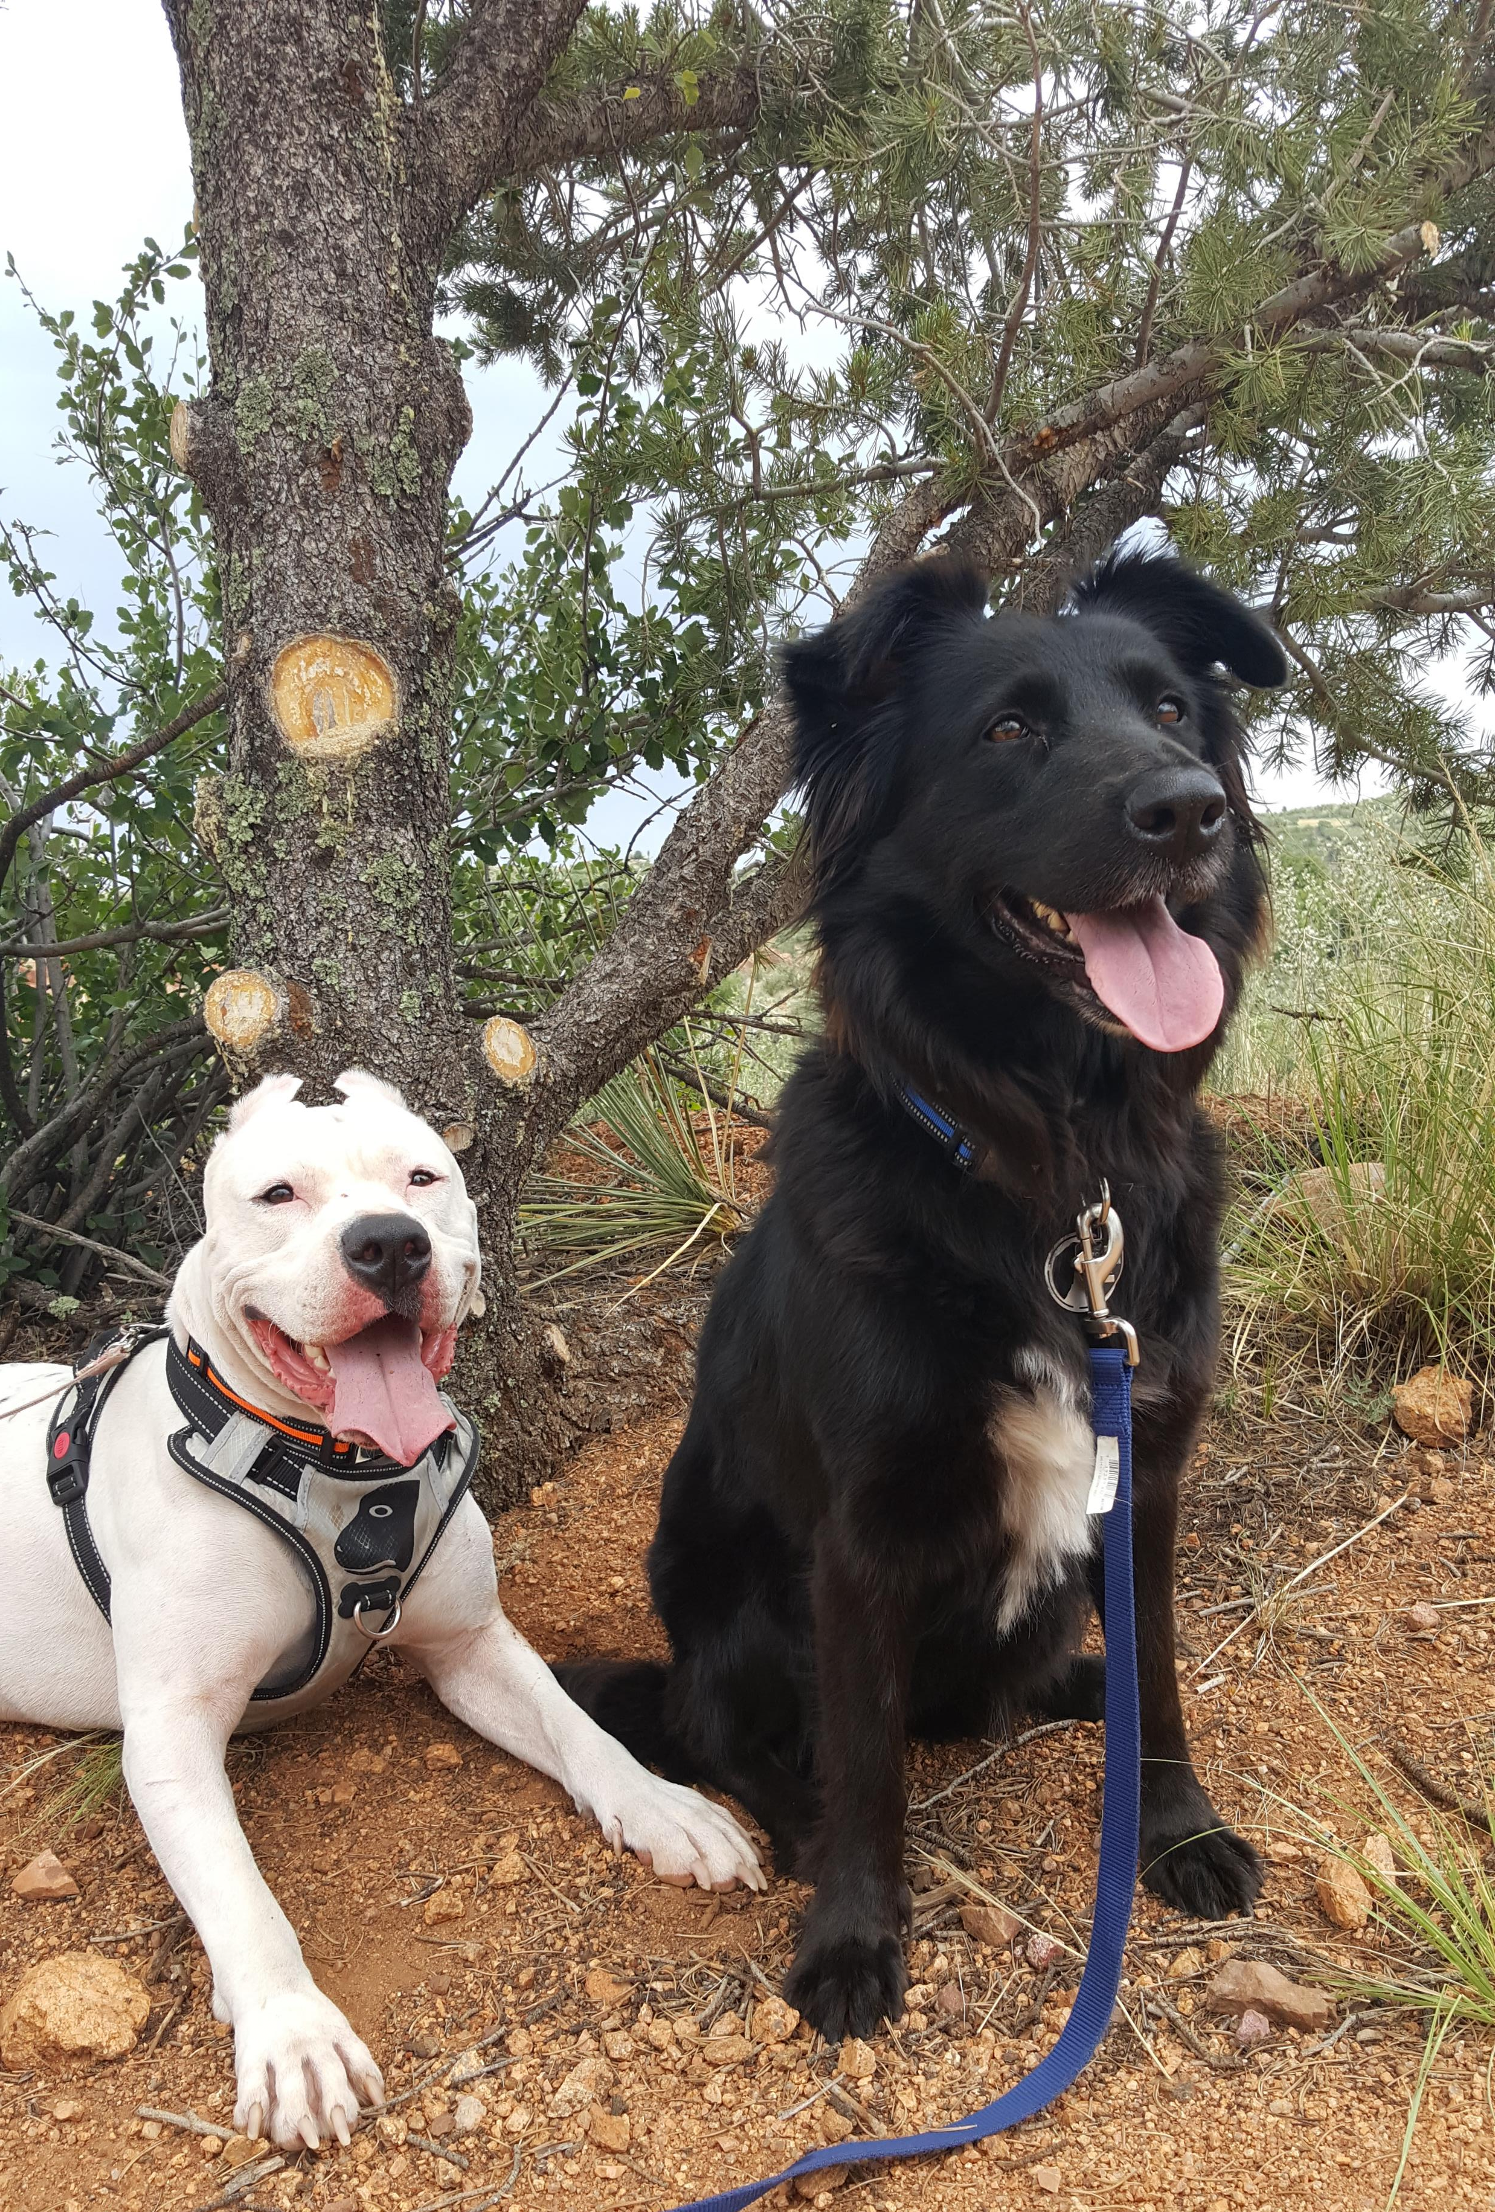
R Lab Week 1: Indexing and Subsetting
L Burleigh
Office Hours: Fridays @ 11 am – 12 pm, Audubon B3
These slides available at:
Course Moodle > Lab Materials > R Lab Session Files > Lab 1 > Reference Guide

Slide 2
Moodle
Lab Materials
Files needed or created for lab sessions
Lab activities
R Tutorials and Resources
Extra R fun

Slide 3
Lab Objectives
Get comfy with Rstudio
Load data from .csv
Access and reference values/variables from dataframe
Creating values/variables in and out of dataframe
Basic arithmetic with and without functions
IMPORTANT INSTALLATION NOTE!!
Download R then download Rstudio

Slide 4
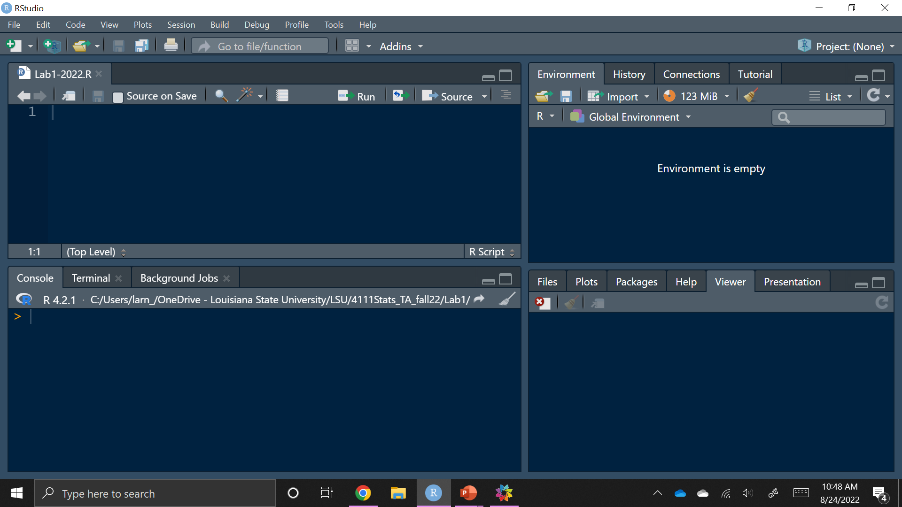
RStudio
Notes:
Script – this file can be saved so the code kept here can be found later
Console – code here is not saved in a file! Good space for working out options and testing issues so the final, correct code can be put in the script to be saved
Environment tab – Variables, objects, lists, etc. that are actively called in to R and can be referred to appear here. If it is not here, it CANNOT actively be called/used
History tab – Shows code that has been run
Files tab – shows files that Rstudio sees on your computer in particular location
Plots tab – when creating a plot or figure, it will appear here when called
Packages tab – see what packages/libraries are installed and many that are available
Help tab – find guide for functions here. R guides have a particular look and need a bit of time to become familiar with how to find the important information, but this is such a helpful skill to acquire as it will allow you to be able to understand most functions, even if you haven’t used them before! [see code page for how to pull up from console]
Brooms – clicking on an icon of a broom will clear the space of the window it is associated with. This means whatever is in the space/window will no longer be active and need to be called back in to refer to it
This line indicates the current version of Rstudio and current working directory

Slide 5
Rstudio Color Guide Breakdown
Script – this file can be saved so the code kept here can be found later
Console – code here is not saved in a file! This space is the code that is run, which can either be typed directly into the console or run from the script
Environment tab – Variables, objects, lists, etc. that are actively called in to R and can be referred to appear here. If it is not here, it CANNOT actively be called/used
History tab – Shows code that has been run
Files tab – shows files that Rstudio sees on your computer in particular location
Plots tab – when creating a plot or figure, it will appear here when called
Packages tab – see what packages/libraries are installed and many that are available
Help tab – find guide for functions here. R guides have a particular look and need a bit of time to become familiar with how to find the important information, but this is such a helpful skill to acquire as it will allow you to be able to understand most functions, even if you haven’t used them before! [see code page for how to pull up from console]
Brooms – clicking on an icon of a broom will clear the space of the window it is associated with. This means whatever is in the space/window will no longer be active and need to be called back in to refer to it
This line indicates the current version of Rstudio and current working directory

Slide 6
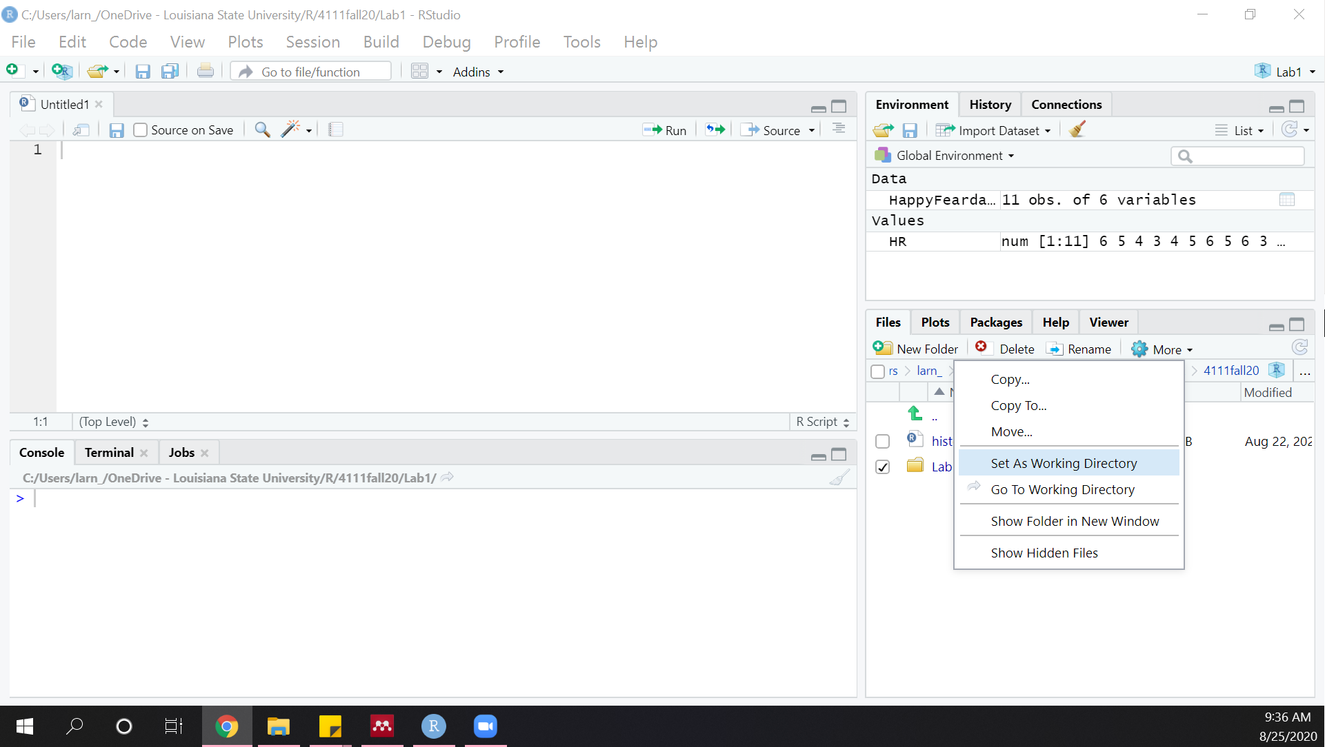
Setting the Working Directory

Slide 7
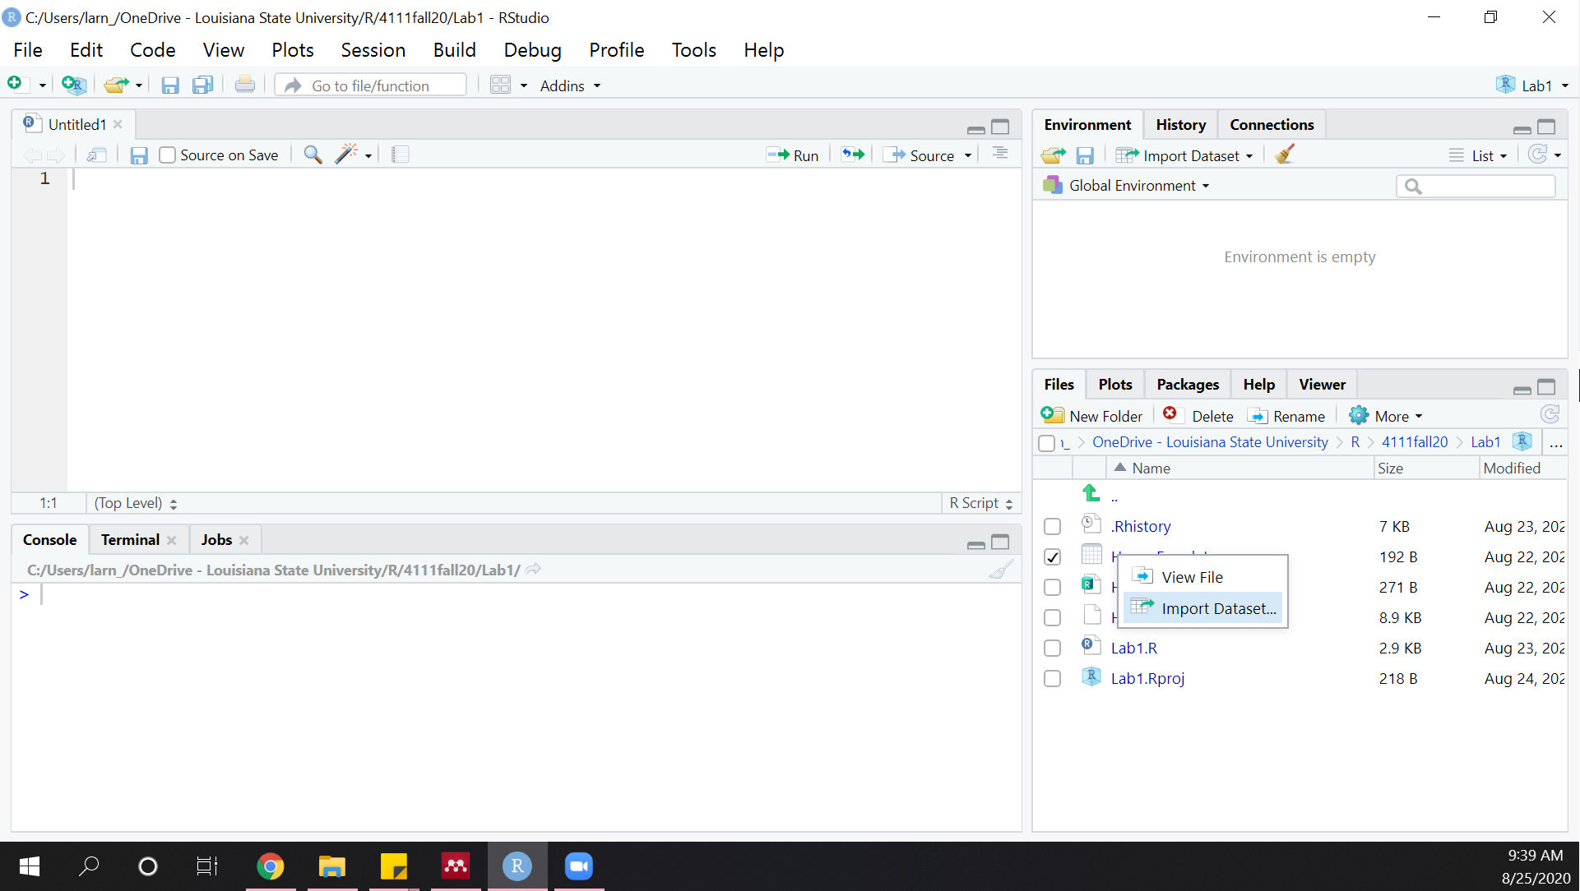
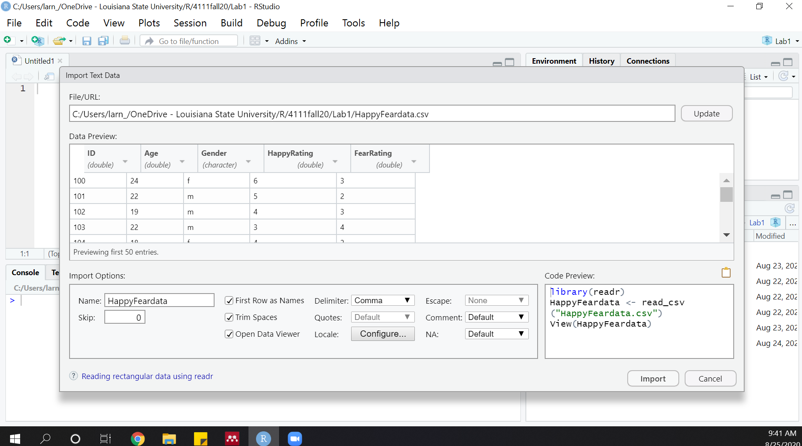
Load a CSV

Slide 8
Terminology
Indexing – iterating through values/rows/participants/etc.
Subsetting – using a portion of all the values/rows/participants/etc.
Dataframe – two-dimensional structure [rows, columns]
Usually how data bases should be called into and accessed in R
Variable – column in a dataframe
Object – a created ‘code’ to access. 6 types: vector, list, matrix, array, factor, dataframe
Functions - a predefined set of tasks performed on the arguments given
In R, functions have the format: functionname(argument1, argument2, ...)
The function name is the function’s identification name as defined when the function was created
Arguments are the pieces of info the function needs to run the predefined tasks. Many functions have required and optional arguments. Most required, and some optional, arguments are ORDER SPECIFIC. Many optional arguments must be fully defined with the name and input (more on this later).

Slide 9
Helpful Code
Task | Code
Search for help guide | ??function ??package
Set working directory | Setwd(“directory/desired/to/work/from”)
Report variables in dataframe | names(dataframe)
View dataframe | View(dataframe)
Report row ‘i’ and column ‘j’ | dataframe[i,j]
Extract variable named ‘foo’ | dataframe$foo
Create new object called ‘x’ and assign the value ‘4’ to it | x <- 4
Create new column in dataframe named ‘ThisOne’ with ‘y’ in cells | dataframe$ThisOne <- y

